Slide 1
NSQ1, Session 8
Graph databases

Slide 2
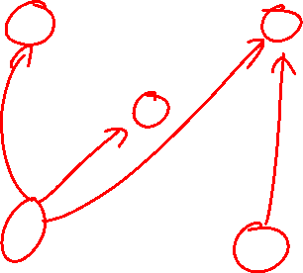
What is a graph?
A collection of nodes connected with edges
Traditionally used to model road networks, power grids, computer networks, etc.
Allow for a vast array of algorithms

Slide 3









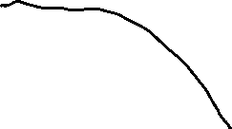



Data stored in a graph

Slide 4
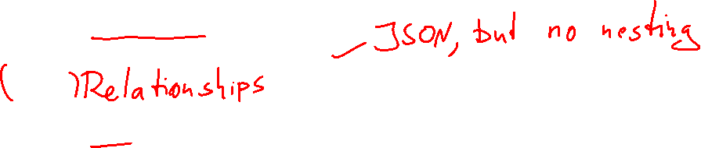
Elements of a neo4j graph
Nodes
Contain the entities
Have one or more labels
Have any number of attributes
Edges
Contain the relationships
Have one type
Have any number of attributes
Attributes
Primitives (number, date, string, …)
Arrays of primitives
No embedded objects

Slide 5
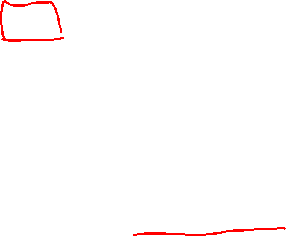
2 use cases
OLTP (Online transactional processing)
Several different node labels
Several different edge types
Heavy use of Cypher (the neo4j SQL alternative)
OLAP (Online analytical processing)
Very similar nodes
Only one edge type
Heavy use of graph algorithms
Often created from an OLTP database

Slide 6
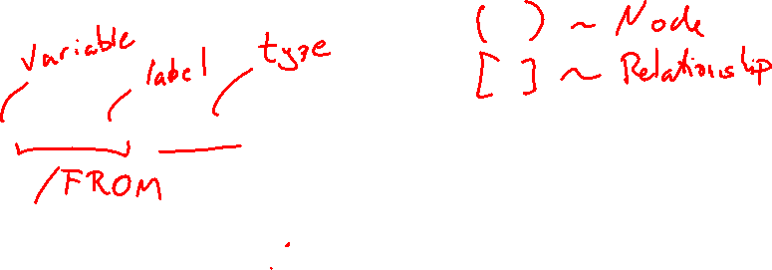
Cypher (main ideas)
Inspired by SQL
Based on patterns: (n:Person)-[:lives]->(a:Address)
MATCH instead of JOIN
built-in relationships
Pipeline
You can handle astonishing things in just one statement
WHERE clauses
but you can handle a lot of conditions in the MATCH
Powerful

Slide 7





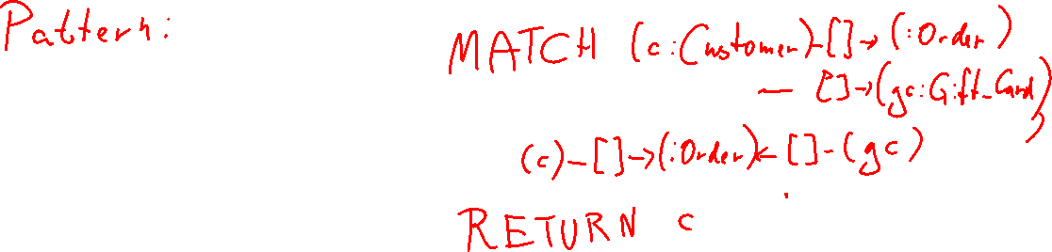


Searching with patterns: Who bought a gift card for themselves?

Slide 8
Getting started
Download the community edition from neo4j.com
Follow the installation guide for the first 3 steps
Follow the linked tutorial including the questions
(Extra) Try your hand at the blog exercises

